Slide 1
Book Reports

Slide 2
Choosing a Book!
Click here for an example!
Questions to Ask:
Is it a chapter Book
Is the book in your Lexile range?
Is it a book you haven’t read before?
Is it a Reading Counts Quiz book?
Have you conferenced with Miss Frueh to approve the book?

Slide 3
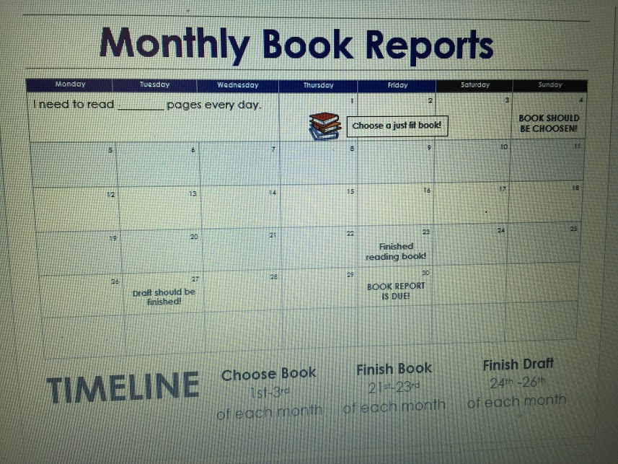
Set timeline to finish book
Questions to ask:
When is report due?
How long is the book?
How many pages need to be read each day?
Use the Monthly Book Report Calendar to help set a timeline.
Click HERE!
Leave at least 10 days to write report

Slide 4
While reading your book...
Take notes while reading
Ask questions about difficult words
Make predictions
Identify key details of the book
*Setting *Characters *Problem *Solution
You will need:
book
place to read
Pencil
Notetaking Page
otetaking page

Slide 5
Elements of Your
Book Report

Slide 6
Introduction
Paragraph 1
Should include:
Book title
Author
Genre
Reading level
Transition to next paragraph
Use complete sentences!

Slide 7
Major Characters
Paragraph 2
Casey Baumer
Jude Parker
Ashley Wilson
Jake Tanner
The characters that are critical in making the book come to life.

Slide 8
Minor Characters
Paragraph 2
Mrs. Street
Mr. Jones
Suzie
James
Characters who help the major characters but have very little role in the actual story line.

Slide 9
Setting
Paragraph 3
Where did it happen?
How about when??
If needed include background of culture, city, and events of time period
What year was it?
Detailed description of main setting locations

Slide 10
Problem
Paragraph 4
What is the main problem?
How did characters try to solve the problem?
What was the character's reaction to the problem?
Events that caused problem to worsen or improve?
How did the problem cause characters to interact with one another

Slide 11
Plot
Paragraph 4
Is there a theme to the book?
Moral or lesson to be learned?
Did the author follow a particular pattern?

Slide 12
Solution
Paragraph 5
How did main characters overcome the problem
What was the solution?
What events lead up to the solution?
Any surprises or suspense?

Slide 13
Conclusion
Paragraph 5
Would you recommend this book? Write your opinion.

